Slide 1
Inheritance
‹#›
Notes:
‹#›

Slide 2
#include #include using namespace std; class Pet { public: // Constructors, Destructors Pet(): weight(1), food("Pet Chow") {} ~Pet() {} //Accessors void setWeight(int w) {weight = w;} int getWeight() {return weight;} void setfood(string f) {food = f;} string getFood() {return food;} //General methods void eat(); void speak(); protected: int weight; string food; }; void Pet::eat() { cout << "Eating " << food << endl; } void Pet::speak() { cout << "Growl" << endl; } class Rat: public Pet
class Rat: public Pet { public: Rat() {} ~Rat() {} //Other methods void sicken() {cout << "Spreading Plague" << endl;} };
class Cat: public Pet { public: Cat() : numberToes(5) {} ~Cat() {} //Other accessors void setNumberToes(int toes) {numberToes = toes;} int getNumberToes() {return numberToes;} private: int numberToes; }; int main() { Rat charles; Cat fluffy; charles.setWeight(25); cout << "Charles weighs " << charles.getWeight() << " lbs. " << endl; charles.speak(); charles.eat(); charles.sicken(); fluffy.speak(); fluffy.eat(); cout << "Fluffy has " << fluffy.getNumberToes() << " toes " << endl; return 0; }
‹#›
Notes:
‹#›

Slide 3
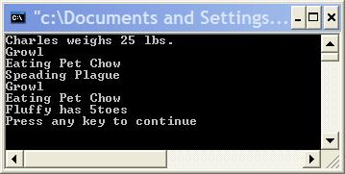
Output
‹#›
Notes:
‹#›

Slide 4
comments
notice that the data members of the Pet base class are declared as protected. Protected indicates that publicly derived subtypes of the base class will be able to directly access these variables.
If they were declared to be private, only the Pet class could directly access them; subclasses could not.
If they were declared public, any class or part of code could accessed them. This would defeat a key goal of object-oriented design: encapsulating data within a class and exposing the data only through the public interface.
‹#›
Notes:
‹#›

Slide 5
comments
The last thing to notice in this example is that constructorsThe last thing to notice in this example is that constructors, including copy constructorsThe last thing to notice in this example is that constructors, including copy constructors, and destructors are not inherited. Each subtype has its own constructor and destructor.
‹#›
Notes:
‹#›

Slide 6
comments
Rat and Cat objects inherit the methods of the base class, Pet. We can call the speak method and the eat method on objects of type Rat and Cat. These methods were defined only in Pet and not in the subclasses.
Also, notice the each subclass extends the base class by adding methods and members. The Rat class has the "sicken" method. The Cat class has methods and members related to the number of toes an individual cat object has.
This is the most common software reuse by extending additional behaviors in OO system development
‹#›
Notes:
‹#›

Slide 7
basic principle of inheritance
The base class contains common members and methods used by the subclasses
The subtypes are more specialized than the base class.
‹#›
Notes:
‹#›

Slide 8
#include #include using namespace std; class Pet { public: // Constructors, Destructors Pet(): weight(1), food("Pet Chow") { cout << "Pet Constructor" << endl; } ~Pet() { cout << "Pet Destructor" << endl; } // Rest of code unmodified from first example ...... }; class Rat: public Pet { public: Rat() { cout << "Rat Constructor" << endl; } ~Rat() { cout << "Rat Destructor" << endl; } // Rest of code unmodified from first example ...... }; class Cat: public Pet
#include class Cat: public Pet { public: Cat() : numberToes(5) { cout << "Cat Constructor" << endl; } ~Cat() { cout << "Cat Destructor" << endl; } // Rest of code unmodified from first example ...... }; int main() { Rat charles; Cat fluffy; //charles.setWeight(25); //cout << "Charles weighs " << charles.getWeight() << " lbs. " << endl; //charles.speak(); //charles.eat(); //charles.sicken(); //fluffy.speak(); //fluffy.eat(); //cout << "Fluffy has " << fluffy.getNumberToes() << "toes " << endl; return 0; }
‹#›
Notes:
‹#›

Slide 9
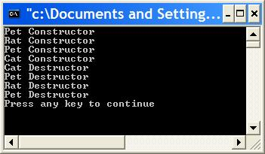
output
‹#›
Notes:
‹#›

Slide 10
comments
The base classThe base class part of an object is always constructed first and destroyed last. The subclass part of an object is constructed last and destroyed first.
The reason for this is that each object of a subtype consists of multiple parts, a base class part and a subclass part. The base class constructor forms the base class part. The subclass constructor forms the subclass part. Destructors clean up their respective parts.
每一個 subclass 要自行負責建構與清除自己的特異化的的部分
‹#›
Notes:
‹#›

Slide 11
Passing arguments into constructors
In the previous example, all the classes used default constructors. That is, the constructors took no arguments. Suppose that there were constructors that took arguments. How would this be handled? Here's a simple example.
‹#›
Notes:
‹#›

Slide 12
int main() { Rat charles(25,"Rat Chow"); Rat john;//Default Rat constructor Cat fluffy(10,"rats"); Cat buffy(10,"fish",6); cout << "Charles weighs " << charles.getWeight() << " lbs. " << endl; charles.speak(); charles.eat(); charles.sicken(); cout << "John weighs " << john.getWeight() << " lbs. " << endl; john.speak(); john.eat(); john.sicken(); fluffy.speak(); fluffy.eat(); cout << "Fluffy has " << fluffy.getNumberToes() << "toes " << endl; buffy.speak(); buffy.eat(); cout << "Buffy has " << buffy.getNumberToes() << "toes " << endl; return 0; }
#include <iostream> #include <string> using namespace std; class Pet { public: // Constructors, Destructors Pet () : weight(1), food("Pet Chow") {} Pet(int w) : weight(w), food("Pet Chow") {} Pet(int w, string f) : weight(w), food(f) {} ~Pet() {} //Accessors void setWeight(int w) {weight = w;} int getWeight() {return weight;} void setfood(string f) {food = f;} string getFood() {return food;} //General methods void eat(); void speak(); protected: int weight; string food; };
void Pet::eat() { cout << "Eating " << food << endl; } void Pet::speak() { cout << "Growl" << endl; } class Rat: public Pet { public: Rat() {} Rat(int w) : Pet(w) {} Rat(int w, string f) : Pet(w,f) {} ~Rat() {} //Other methods void sicken() {cout << "Speading Plague" << endl;} }; class Cat: public Pet { public: Cat() : numberToes(5) {} Cat(int w) : Pet(w), numberToes(5) {} Cat(int w, string f) : Pet(w,f), numberToes(5) {} Cat(int w, string f, int toes) : Pet(w,f), numberToes(toes) {} ~Cat() {} //Other accessors void setNumberToes(int toes) {numberToes = toes;} int getNumberToes() {return numberToes;} private: int numberToes; };
‹#›
Notes:
‹#›

Slide 13
comments
Rat and Cat constructors that take arguments, which are in turn passed to the appropriate Pet constructor. The base class, Pet, constructor is added to the member initialization list of the derived class constructors.
Also notice that for the derived class (Rat and Cat) default constructors, the Pet default constructor does not need to be explicitly called.
‹#›
Notes:
‹#›

Slide 14
A complete list of invoked constructors
Rat charles(25,"Rat Chow"); Pet(int w, string f) Rat(int w, string f) Rat john; Pet() Rat() Cat fluffy(10,"rats"); Pet(int w, string f) Cat(int w, string f) Cat buffy(10,"fish",6); Pet(int w, string f) Cat(int w, string f, int toes)
‹#›
Notes:
‹#›

Slide 15
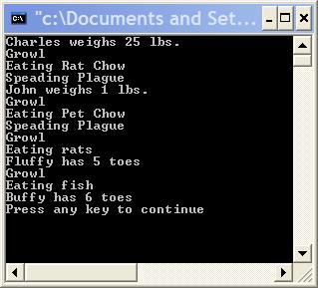
Output
‹#›
Notes:
‹#›

Slide 16
Overriding methods
A derived classA derived class can use the methods of its base classA derived class can use the methods of its base class(es), or it can override them.
The method in the derived class must have the same signature and return type as the base class method to override.
The signature is number and type of arguments and the constantness (const, non- const) of the method. When an object of the base class is used, the base class method is called.
Note that overriding is different from overloading. With overloading, many methods of the same name with different signatures (different number and/or types of arguments) are created.
With overriding, a subclass implements its own version of a base class method. The subclass can selectively use some base class methods as they are, and override others.
‹#›
Notes:
‹#›

Slide 17
class Rat: public Pet { public: Rat() {} Rat(int w) : Pet(w) {} Rat(int w, string f) : Pet(w,f) {} ~Rat() {} //Other methods void sicken() {cout << "Speading Plague" << endl;} void speak(); }; void Rat::speak(){ cout << "Rat noise" << endl;} class Cat: public Pet { public: Cat() : numberToes(5) {} Cat(int w) : Pet(w), numberToes(5) {} Cat(int w, string f) : Pet(w,f), numberToes(5) {} Cat(int w, string f, int toes) : Pet(w,f), numberToes(toes) {} ~Cat() {} //Other accessors void setNumberToes(int toes) {numberToes = toes;} int getNumberToes() {return numberToes;} //Other methods void speak(); private: int numberToes; }; void Cat::speak() { cout << "Meow" << endl; } int main() { Pet peter; Rat ralph; Cat chris; peter.speak(); ralph.speak(); chris.speak(); return 0; l }
#include <iostream> #include <string> using namespace std; class Pet { public: // Constructors, Destructors Pet () : weight(1), food("Pet Chow") {} Pet(int w) : weight(w), food("Pet Chow") {} Pet(int w, string f) : weight(w), food(f) {} ~Pet() {} //Accessors void setWeight(int w) {weight = w;} int getWeight() {return weight;} void setfood(string f) {food = f;} string getFood() {return food;} //General methods void eat(); void speak();
protected: int weight; string food; }; void Pet::eat() { cout << "Eating " << food << endl; } oid Pet::speak() { cout << "Growl" << endl; }
‹#›
Notes:
‹#›

Slide 18
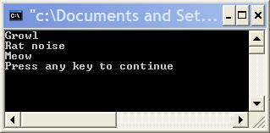
output
‹#›
Notes:
‹#›

Slide 19
Notice
remember that the return type and signature of the subclass method must match the base class method exactly to override.
Another important point is that if the base class had overloaded a particular method, overriding a single one of the overloads will hide the rest.
For instance, suppose the Pet class had defined several speak methods.
‹#›
Notes:
‹#›

Slide 20
Be very careful!
These are overloaded methods
void speak(); void speak(string s); void speak(string s, int loudness); If the subclass, Cat, defined only void speak(); Then speak() would be overridden. speak(string s) and speak(string s, int loudness) would be hidden. This means that if we had a cat object, fluffy, we could call: fluffy.speak(); But the following would cause compilation errors. fluffy.speak("Hello"); fluffy.speak("Hello", 10);
Generally, if you override an overloaded base class method you should either override every one of the overloads, or carefully consider why you are not. It is a safety protocol enforced by compiler to prevent you from doing such error
‹#›
Notes:
‹#›

Slide 21
The Principle of Inheritance
‹#›

Slide 22


Slide 23

This class is representing two ADTs: an employee and a ListContainer.

Slide 24
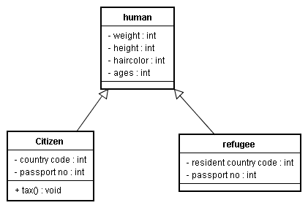
To subclass or not to subclass?
Consider you are a UN (United Nation ) staff
‹#›
Notes:
‹#›

Slide 25
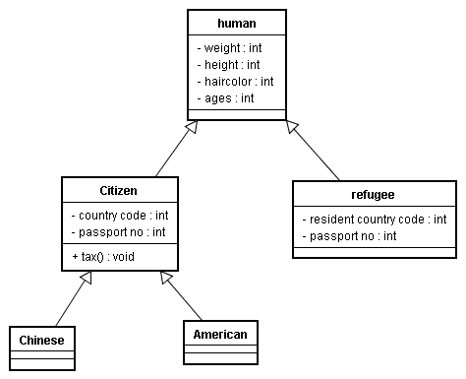
Do you want to keep going?
‹#›
Notes:
‹#›

Slide 26
The answer
No
The country code is already capable of distinguishing citizenships of country
This subclassing is meaningless until
‹#›
Notes:
‹#›

Slide 27
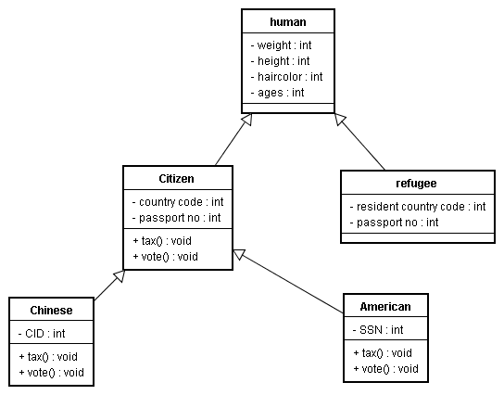
Until object’s behaviors must be specialized and distinguished
vote() {
vote country leader
}
vote() {
vote country leader
vote referendum
}
vote() {
sorry
}
‹#›
Notes:
‹#›

Slide 28
Thumb Rule
A citizen is a human?
An American is a citizen?
=> An american is a human?
Inheritance relation is transitive
A Chinese is a citizen?
A citizen is a human?
A Chinese is a human?
‹#›
Notes:
‹#›

Slide 29
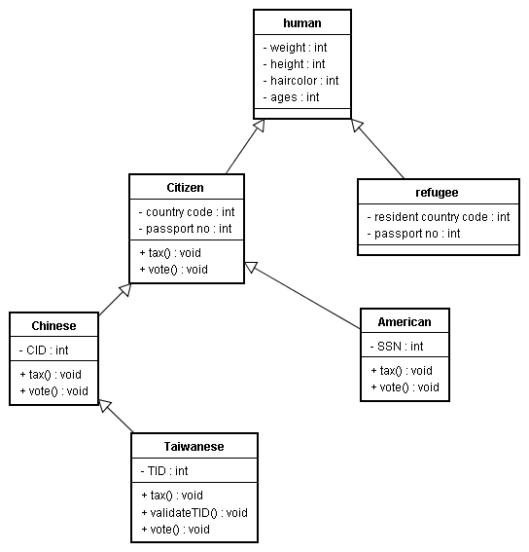
To subclass or not to subclass? The UN staff wants to follow one-China policy
Taiwanese all inherit CID
Taiwanese overrides the tax() and vote() method
Taiwanese has a specialized attributes called TID
Taiwanese has a new method to validate if a TID is valid.
‹#›
Notes:
‹#›

Slide 30
By so inheriting, the UN staff means
Taiwanese is a Chinese, is a citizen, and is a human
Chinese is not necessary a Taiwanese
Taiwanese has an attribute called CID, but is never used (this is something wrong)
OK..This is very heavy
‹#›
Notes:
‹#›

Slide 31
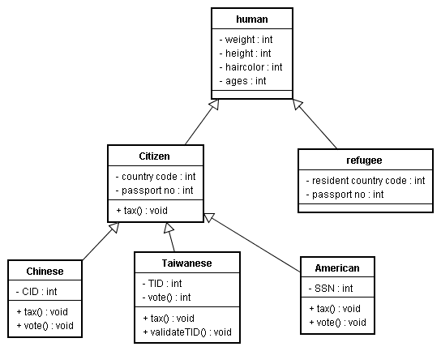
How about this inheritance?
‹#›
Notes:
‹#›

Slide 32
By this inheritance, you mean
Taiwanese is not a Chinese
But Taiwanese and Chinese are both citizens and human.
Taiwanese does not inherit CID attributes
‹#›
Notes:
‹#›

Slide 33
More exercise of overriding
#include <iostream>
using namespace std ;
class pet {
public:
pet() { cout << "pet constructor" << endl ; }
~pet() { cout << "pet destructor" << endl ; }
void speak() { cout << "Growl " << endl ; }
};
class cat: public pet {
public:
cat() { cout << "cat constructor" << endl ; }
~cat() { cout << "cat destructor" << endl ; }
void speak() { cout << "meow" << endl ; }
};
main() {
pet insect ;
cat pussy ;
pet * nose = (pet *) new cat();
insect.speak();
pussy.speak();
((pet) pussy).speak();
nose-> speak();
}
‹#›
Notes:
‹#›

Slide 34
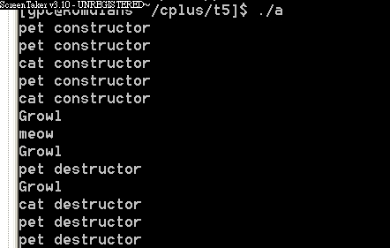
Output
‹#›
Notes:
‹#›

Slide 35
Confused?
When you use a subclass to override a base class’s method, C++ will use the current type to determine the method
This is not the polymorphism you expect.
當你用一個 subclass override 掉 base class 的 method 時，C++ 會根據目前物件的type來幫你呼叫methods
在運用多型的時候，你會不想要讓這樣的事情發生，要怎麼辦？
‹#›
Notes:
‹#›

